Slide 1
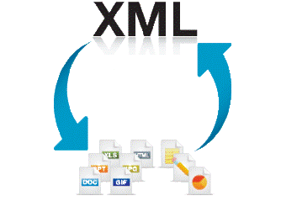

Web Service Testing
RESTful Web Services
Software Quality Assurance
Telerik Software Academy
http://academy.telerik.com

Slide 2


The Lectors
Snejina Lazarova
Project Manager
Business Operations
Dimo Mitev
QA Architect
Backend Services Team

Slide 3

Table of Contents
RESTful Web Services – Main Concepts
REST Concepts
REST Constraints
A RESTful System Main Actors
Resources
Representations
Actions
soapUI

Slide 4
What is a Service?
In the real world a "service" is:
A piece of work performed by a service provider
Provides a client (consumer) some desired result by some input parameters
The requirements and the result are known
Easy to use
Always available
Has quality characteristics (price, execution time, constraints, etc.)

Slide 5
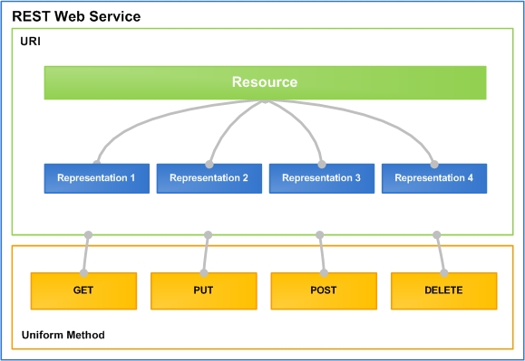
RESTful Web Services
Lightweight Architecture for Web Services

Slide 6
What is REST?
“Representational state transfer (REST) is a style of software architecture for distributed hypermedia systems such as the World Wide Web.”
http://en.wikipedia.org/wiki/Representational_State_Transfer
Application state and functionality are resources
Every resource has an URI
All resources share a uniform interface
This natively maps to the HTTP protocol

Slide 7
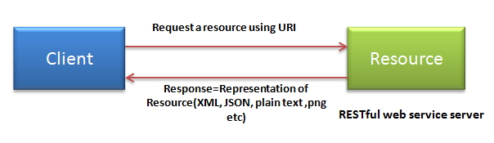
REST Concepts
The architecture consist of
clients and servers
requests and responses
Requests and responses are build around the transfer of representations of resources
Clients contain representations, servers the resources (concepts) themselves

Slide 8
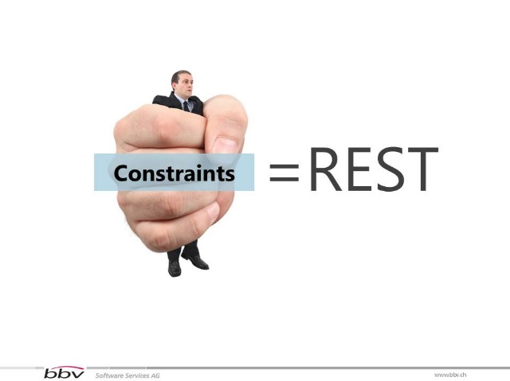
REST Constraints
A RESTful system should be
Client-server
Stateless
Cacheable
Uniformly accessible

Slide 9
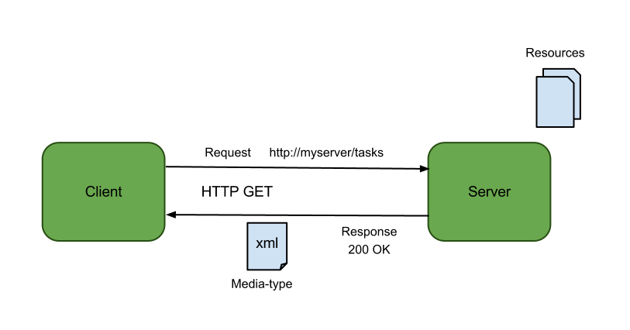
Client-server
Client-server
Clients are separated from servers by a uniform interface

Slide 10
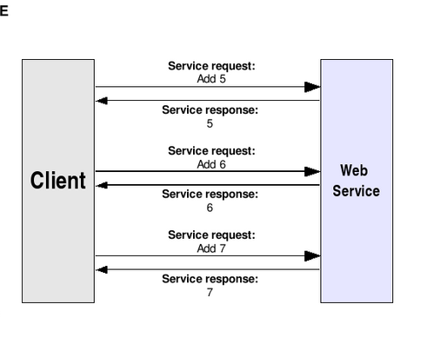
Stateless
Stateless
There should be no need for the service to keep users' session
Each request should be independent of others

Slide 11
Cacheable
Cacheable
Clients are able to cache responses
Responses must, implicitly or explicitly, define themselves as cacheable or not

Slide 12
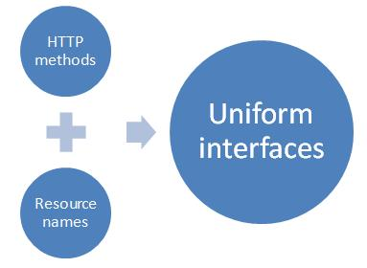
Uniform Accessible
Uniform Accessible
Each resource must have a unique address and a valid point of access

Slide 13
The Web as a RESTful system
You type a URL into your browser to reach a specific HTML page
The browser gets and displays the elements of the HTML page
The browser is getting a representation of the current state of that resource

Slide 14

A RESTful System Main Actors
Resources
Representations
Actions

Slide 15
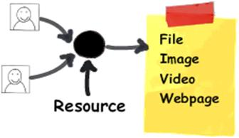
Resources
A resources is "everything" the service can provide
State and functions of a remote application are also considered as resources

Slide 16
Resources (2)
RESTful resource = anything that is addressable over the Web
Addressable = anything that can be accessed and transferred between clients and servers
A resource must have a unique address over the Web
Under HTTP these are URIs

Slide 17
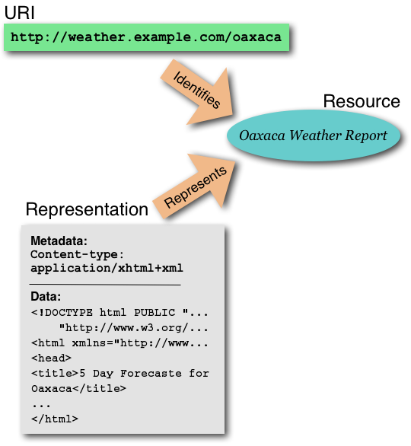
URIs
Uniform Resource Identifier in a RESTful web services is a hyperlink to a resource
It is only means for clients and servers to exchange representations of resources

Slide 18
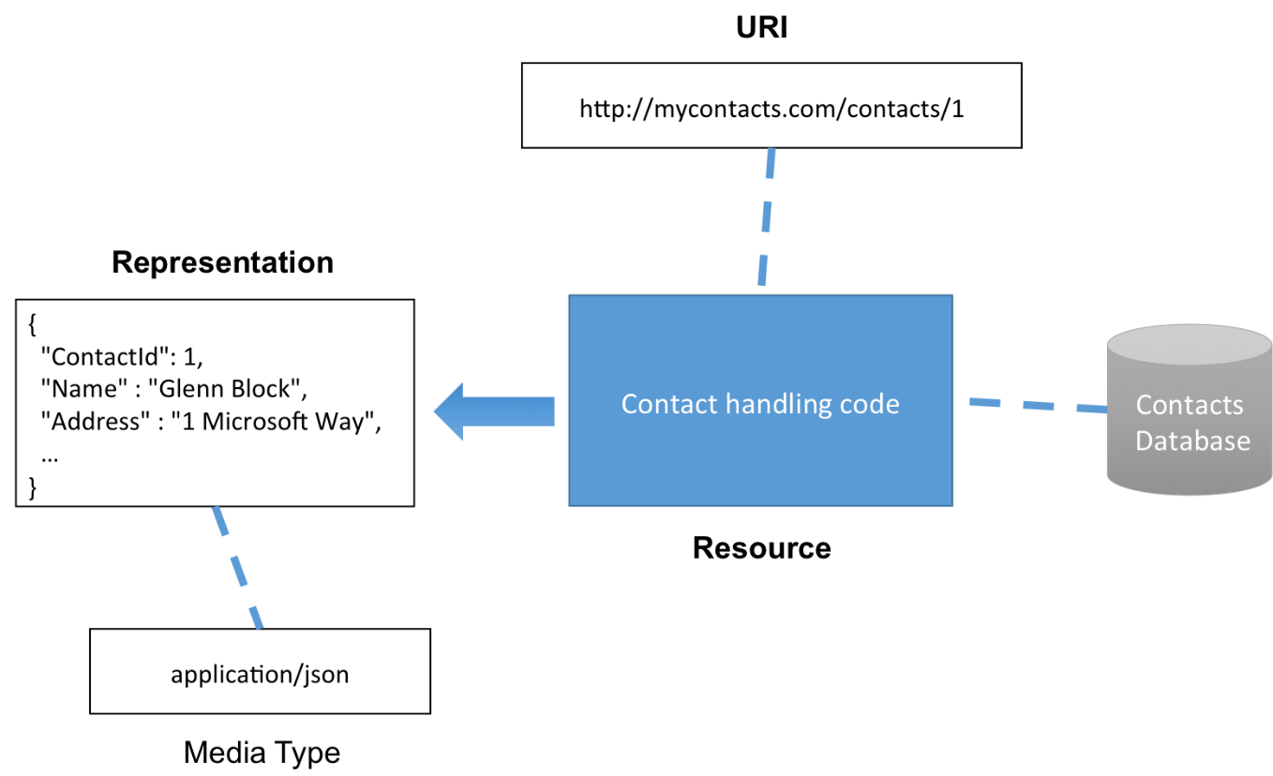
Representations
The representations of resources is what is sent back and forth clients and servers
We never send or receive resources, only their representations

Slide 19
Representations (2)
The format of the representations is determined by the content-type
The interaction of the representation on the resource is determined by the action
POST (create)
GET (read)
PUT (update)
DELETE (delete)

Slide 20
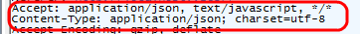
Content-Types
Content type is a reusable collection of settings that you want to apply to a certain category of content
In REST we are using HTTP to communicate and we can transfer any kind of information that can be passed between clients and servers
ex. test files, PDF documents, images, videos

Slide 21
Representation Formats
Different clients are able to consume different representations of the same resource
A representation can take various forms, but its resource has to be available through the same URI

Slide 22
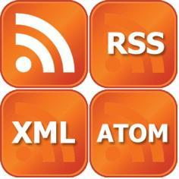
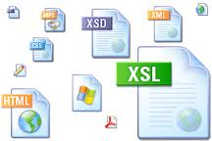

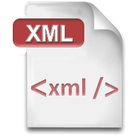


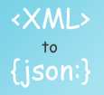

XML, JSON, RSS
Comparing the Common Service Representation Formats

Slide 23

XML
XML is markup-language for encoding documents in machine-readable form
Text-based format
Consists of tags, attributes and content
Provide data and meta-data in the same time
<?xml version="1.0"?>
<library>
<book><title>HTML 5</title><author>Bay Ivan</author></book>
<book><title>WPF 4</title><author>Microsoft</author></book>
<book><title>WCF 4</title><author>Kaka Mara</author></book>
<book><title>UML 2.0</title><author>Bay Ali</author></book>
</library>

Slide 24
JSON
JSON (JavaScript Object Notation)
Standard for representing simple data structures and associative arrays
Lightweight text-based open standard
Derived from the JavaScript language
{
"firstName": "John", "lastName": "Smith", "age": 25,
"address": { "streetAddress": "33 Alex. Malinov Blvd.",
"city": "Sofia", "postalCode": "10021" },
"phoneNumber": [{ "type": "home", "number": "212 555-1234"},
{ "type": "fax", "number": "646 555-4567" }]
},
{ "firstName": "Bay", "lastName": "Ivan", "age": 79 }

Slide 25

RSS
RSS (Really Simple Syndication)
Family of Web feed formats for publishing frequently updated works
E.g. blog entries, news headlines, videos, etc.
Based on XML, with standardized XSD schema
RSS documents (feeds) are list of items
Each containing title, author, publish date, summarized text, and metadata
Atom protocol aimed to enhance / replace RSS

Slide 26
RSS – Example
<?xml version="1.0" encoding="utf-8" ?>
<rss version="2.0">
<channel>
<title>W3Schools Home Page</title>
<link>http://www.w3schools.com</link>
<description>Free web building tutorials</description>
<item>
<title>RSS Tutorial</title>
<link>http://www.w3schools.com/rss</link>
<description>New RSS tutorial on W3Schools</description>
</item>
<item>
<title>XML Tutorial</title>
<link>http://www.w3schools.com/xml</link>
<description>New XML tutorial on W3Schools</description>
</item>
</channel>
</rss>

Slide 27
Actions
Under HTTP, actions are standard HTTP request
POST – create a resource
PUT – update a resource
GET – retrieve a resource
DELETE – delete a resource
They make up the uniform interface used for client/server data transfers

Slide 28
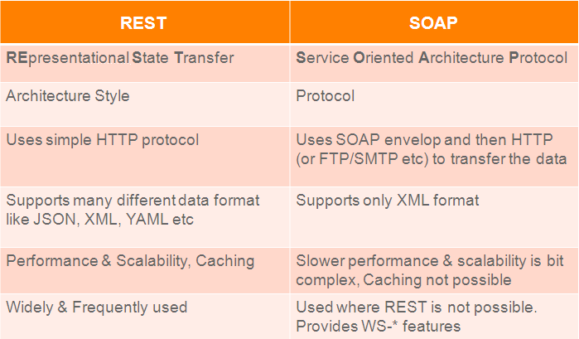
SOAP vs. REST

Slide 29
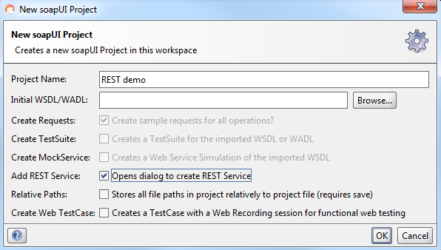
Creating a soapUI Project
Demo
For detailed tutorial see: http://www.soapui.org/REST-Testing/getting-started.html

Slide 30
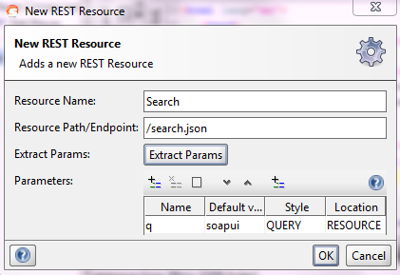
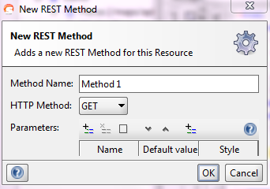
REST Resources and Methods
A REST Service contains any number of resources available on their corresponding path
Resources themselves can have as many levels of child resources as desired
A child resources path will be the concatenation of all its parents’ path with its own

Slide 31
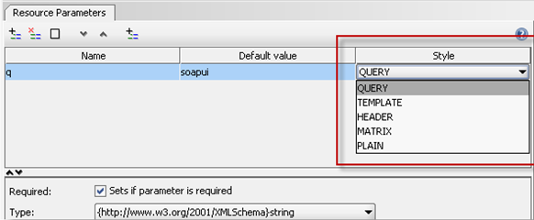
Understanding REST Parameters

Slide 32
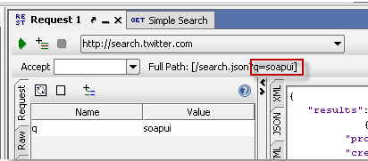
QUERY Parameters
QUERY parameters binds the value of a path segment to a resource method parameter

Slide 33
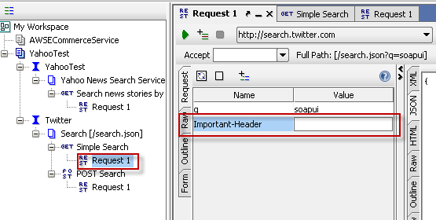
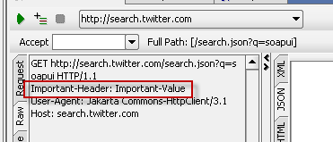
HEADER Parameters
HEADER parameters are instead added as HTTP Headers to the outgoing request

Slide 34
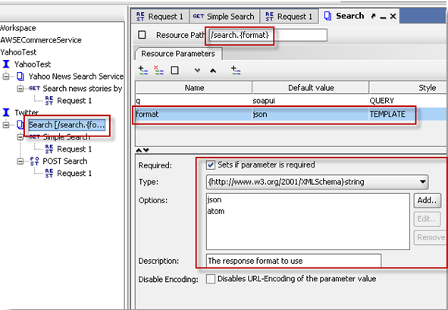
TEMPLATE Parameters
TEMPLATE parameters are a flexible way of parameterizing the actual path of the request

Slide 35
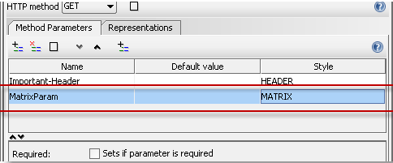
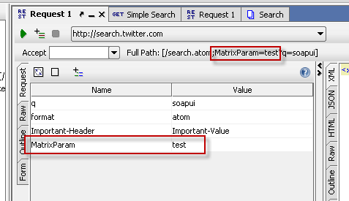
MATRIX Parameters
MATRIX parameters are another way of defining parameters to be added to the actual path of the resource, but before the query string

Slide 36
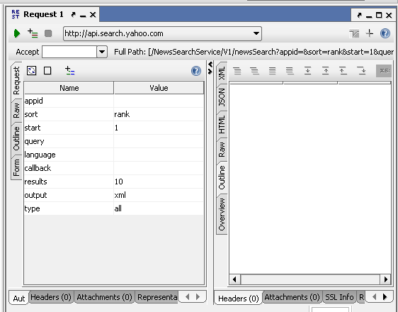
Working with REST Requests
Toolbar
Request
Editor
Response
Editor

Slide 37
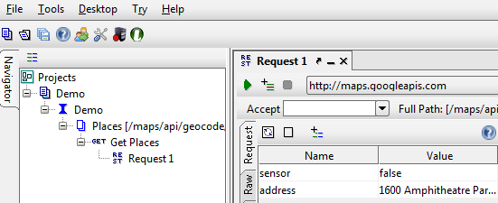
Functional Testing With soapUI
Demo

Slide 38
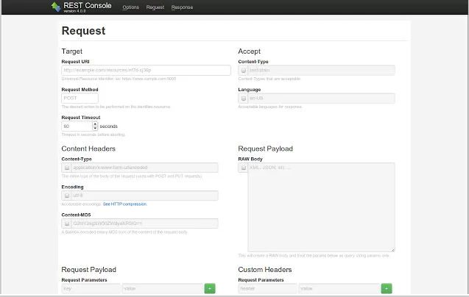
REST Console
REST Console is an HTTP Request Visualizer and Constructor tool, helps developers build, debug and test RESTful APIs

Slide 39
RESTful Web Service Testing
?
?
?
?
?
Questions?
?
?
?
?
?
?

Slide 40
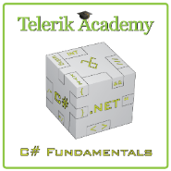



Free Trainings @ Telerik Academy
C# Programming @ Telerik Academy
csharpfundamentals.telerik.com
Telerik Software Academy
academy.telerik.com
Telerik Academy @ Facebook
facebook.com/TelerikAcademy
Telerik Software Academy Forums
forums.academy.telerik.com

